Slide 1
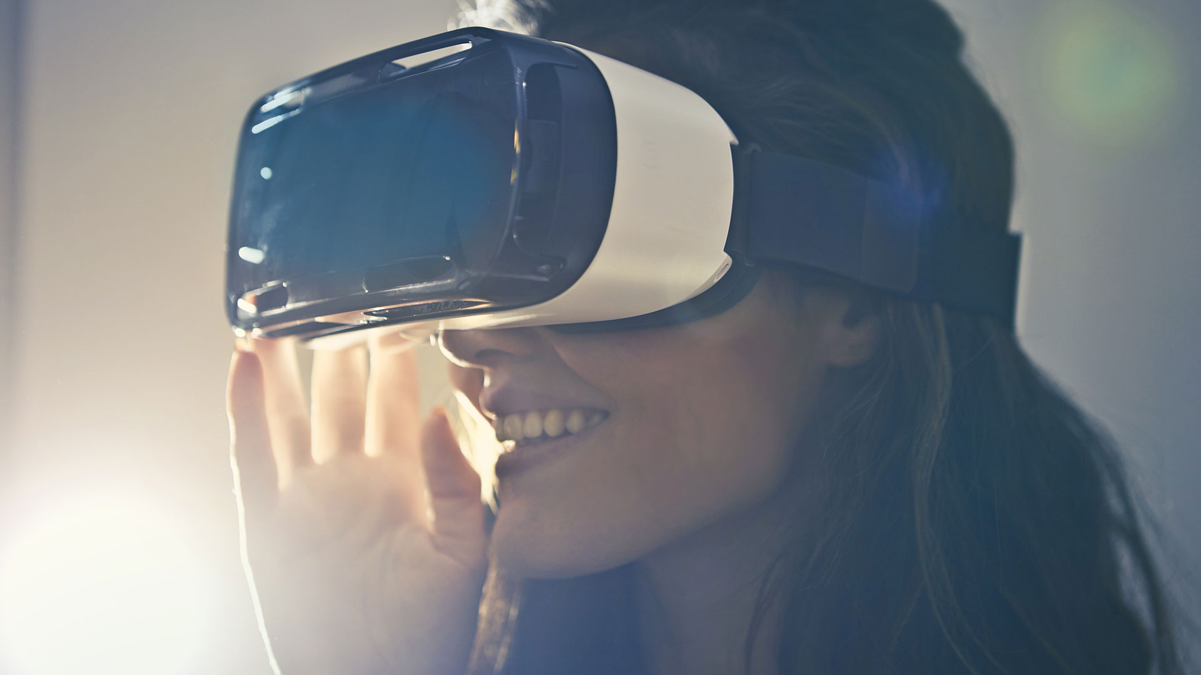
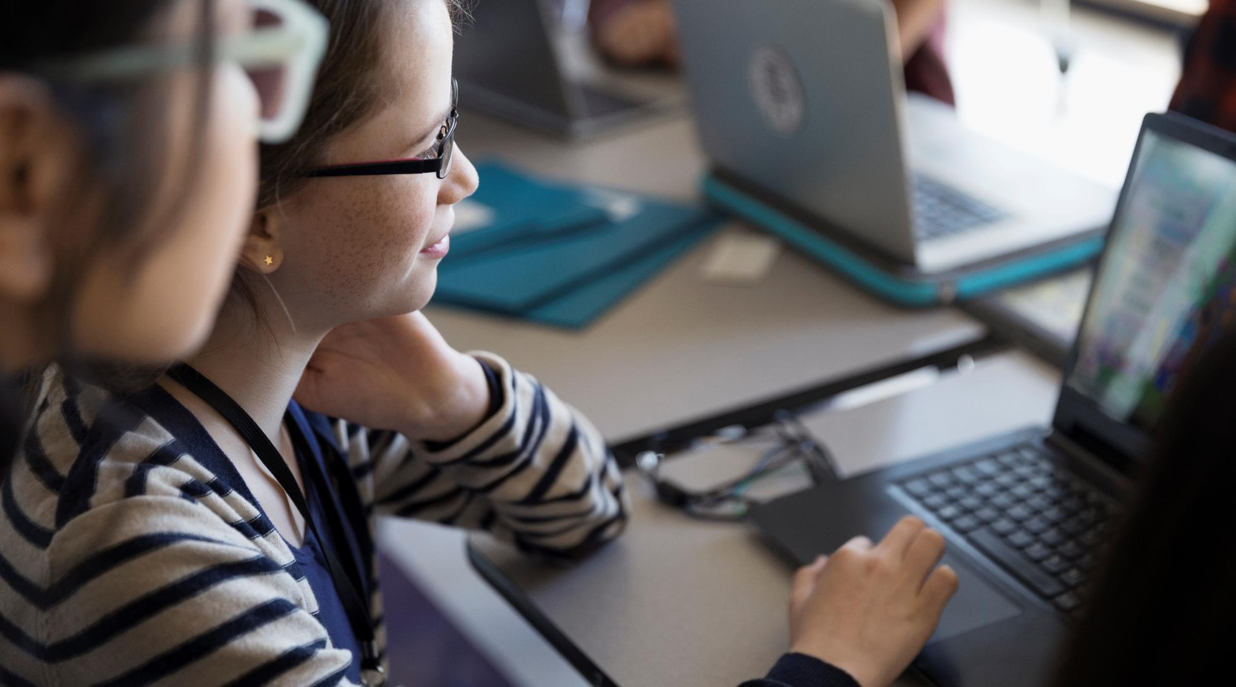

D. Y. Patil College of Engineering, Akurdi, Pune.
Cursor movement using detection of hand gestures
A new way to engage with computer.

Slide 2

Introduction
Problem Statement
Proposed Work
Literature Review
Mathematical model
System Architecture
Algorithm
Feasibility study
Idea matrix
Index

Slide 3
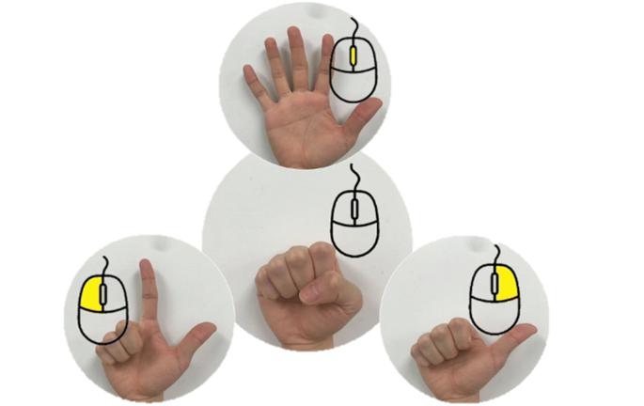
Introduction
It is believed that gestures are the easiest way
of interaction with anyone.
Our proposed project puts forward a hand
gesture based system that allows users to control
the pc mouse movements through the use of hand
movements.
System uses a PC webcam in order to detect hand gesture movements.
Depending on your hand gestures, you can move the cursor and perform left click,
right click, select and scroll up and down, volume up , volume down.

Slide 4

To build hand gesture recognition system which help to create a natural interaction between human and computer where the recognized gestures can be used for controlling cursor movements.
Problem Statement

Slide 5

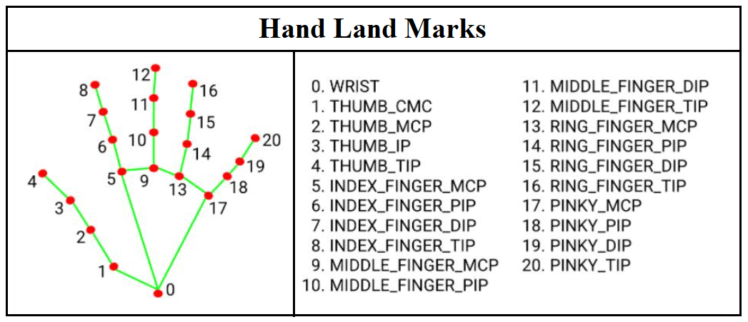
Proposed Work
Firstly, the system continuously scans the camera input for five finger hand-like patterns.
Once a hand is detected, the system then locks it as an object.
These coordinates are then mapped real time onto the mouse cursor to move it according to hand movements.
Some of the Hand Gestures for controlling movements Forefinger movement : Move cursor Raise thumb : Left Click Forefinger & Thumb movement : Change Volume

Slide 6
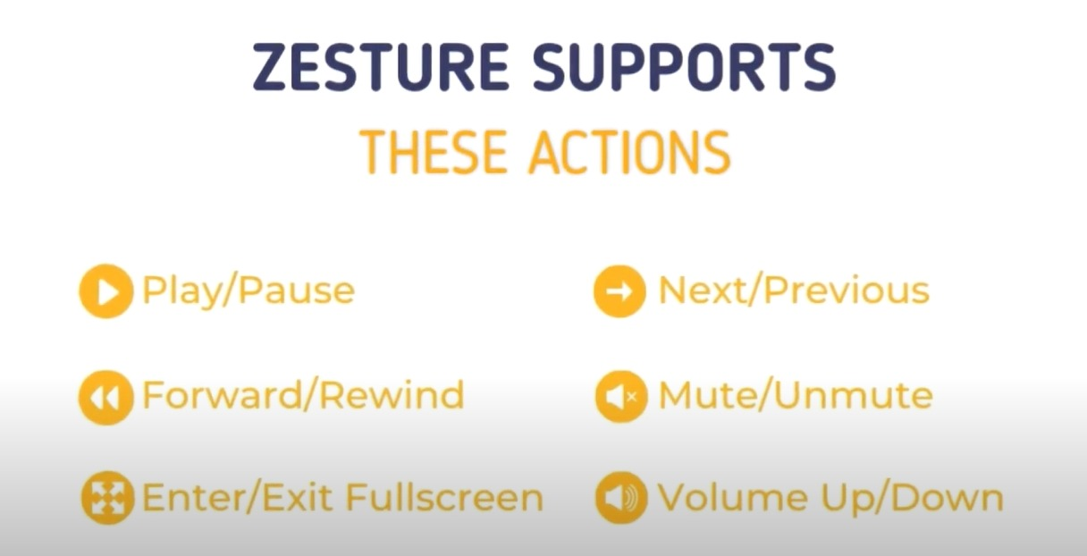

Slide 7
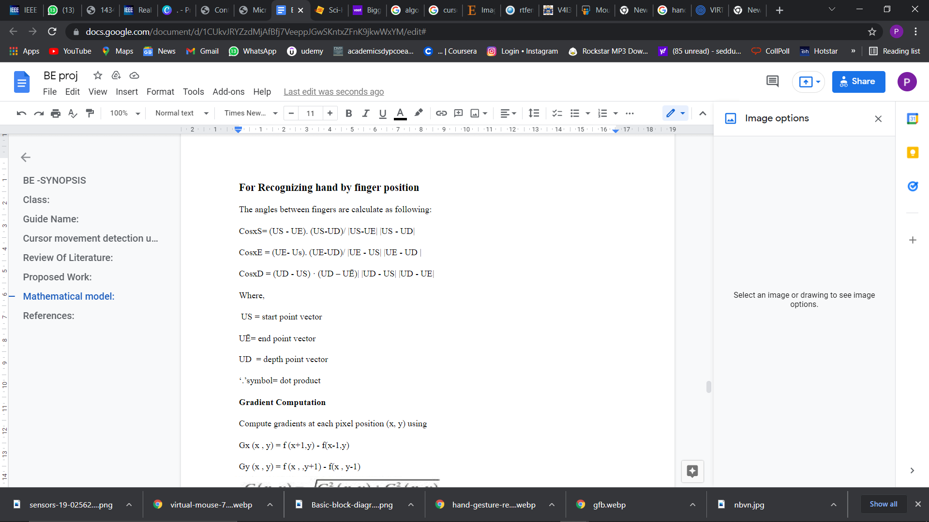
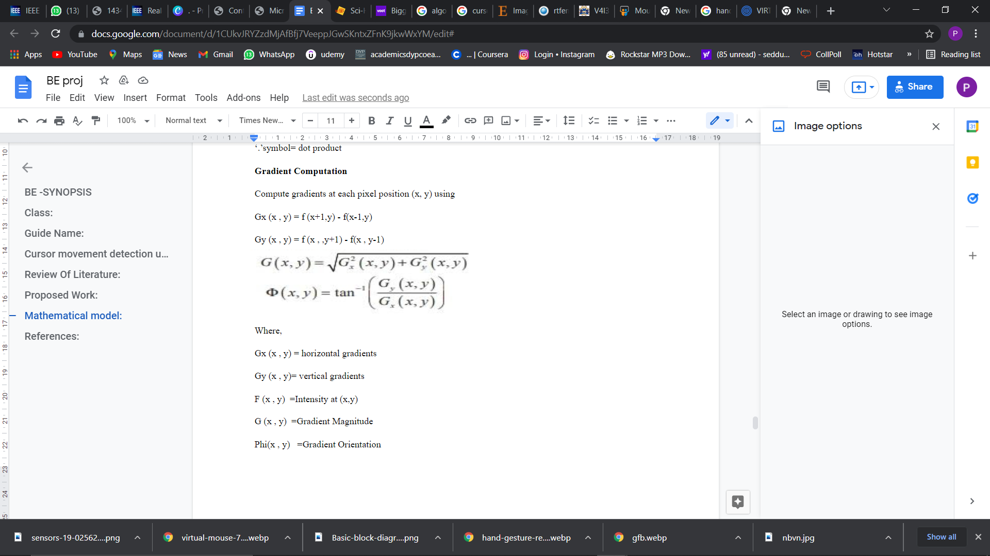
Mathematical Model

Slide 8
Literature Review
Sr. No | Title and Authors | Conference Name and Publication Year | Topic Reviewed/ Algorithms or methodology used | Future Scope
1. | Continuous Finger Gesture Spotting and Recognition Based on Similarities Between Start and End Frames Gibran Benitez-Garcia; Muhammad Haris; Yoshiyuki Tsuda; Norimichi Ukita | G. Benitez-Garcia, M. Haris, Y. Tsuda and N. Ukita, "Continuous Finger Gesture Spotting and Recognition Based on Similarities Between Start and End Frames," in IEEE Transactions on Intelligent Transportation Systems, doi: 10.1109/TITS.2020.3010306. | Gesture recognition based on a temporal normalization of features extracted from the set of spotted frames. This normalization enables the representation of any gesture with the same limited number of features. Ensure real-time performance by proposing an approach based on compact deep neural networks. A realistic driving setup to capture a dataset of continuous finger gestures. | Plan to implement an end to end optimization. To evaluate approach in the presence of natural hand movements that may look like target gestures, as well as in extreme illumination conditions, such as night driving in a real-world environment.

Slide 9
2. | New hand gesture recognition method for mouse operations Ehsan ul Haq; Syed Jahanzeb Hussain Pirzada; Mirza Waqar Baig; Hyunchul Shin | E. u. Haq, S. J. H. Pirzada, M. W. Baig and H. Shin, "New hand gesture recognition method for mouse operations," 2011 IEEE 54th International Midwest Symposium on Circuits and Systems (MWSCAS), 2011, pp. 1-4, doi: 10.1109/MWSCAS.2011.6026330. | Hand gestures can be used for natural and intuitive human-computer interaction. A method combines existing techniques of skin color based ROI segmentation and Viola-Jones Haar-like feature based object detection, to optimize hand gesture recognition for mouse operation. | Improve the performance of appearance-based approaches is degraded by variations in illumination, cluttered backgrounds, and user variance.
3. | A real-time hand gesture recognition method Yafei Zhao; Weidong Wang; Yuehai Wang | Y. Zhao, W. Wang and Y. Wang, "A real-time hand gesture recognition method," 2011 International Conference on Electronics, Communications and Control (ICECC), 2011, pp. 2475-2478, doi: 10.1109/ICECC.2011.6066597. | Presents a real-time hand gesture recognition method. Hand regions are located by combining adaptive skin color detection and motion detection. Recognition results are obtained by the nearest neighbour method. | The dimensionality of the HOG feature space is very high, ranging from several hundred to several thousand. This need to be reduced.
4. | Real-Time Dynamic Hand Gesture Recognition Hsiang Yueh Lai; Han Jheng. Lai | H. Y. Lai and H. J. Lai, "Real-Time Dynamic Hand Gesture Recognition," 2014 International Symposium on Computer, Consumer and Control, 2014, pp. 658-661, doi: 10.1109/IS3C.2014.177. | The eleven kinds of hand gestures have been dynamic recognized, which represent the number from one to nine. The dynamic images are caught by a dynamic video. Used YCbCr color space transformation to detect the skin color and to find the hand contour from the complex background. Finger angles and fingertip positions are calculated to recognize the hand gestures. | The real-time dynamic hand gesture recognition system can be used in the application of HCI, such as wisdom home of our daily life, games, robots, and so on, in the future.

Slide 10
5. | Toward real-time human-computer interaction with continuous dynamic hand gestures Yuanxin Zhu; Haibing Ren; Guangyou Xu; Xueyin Lin | Yuanxin Zhu, Haibing Ren, Guangyou Xu and Xueyin Lin, "Toward real-time human-computer interaction with continuous dynamic hand gestures," Proceedings Fourth IEEE International Conference on Automatic Face and Gesture Recognition (Cat. No. PR00580), 2000, pp. 544-549, doi: 10.1109/AFGR.2000.840688. | This paper, aiming at real-time gesture-controlled interaction, describes visual modeling, analysis, and recognition of continuous dynamic hand gestures. The approach, therefore, fulfills real-time processing as well as high recogn A prototype system, gesture-controlled panoramic map browser, is designed and implemented to demonstrate the usability of gesture-controlled interaction. | In future we can add speech commands which will be an alternative to some gestural commands. Cooperating hand gesture recognition into multi-modal interface (MMI).
6. | Hand Posture Recognition with standard webcam for Natural Interaction C´esar Osimani1‡ , Jose A. Piedra-Fernandez2† , Juan Jesus Ojeda-Castelo3† , and Luis Iribarne4† | Applied Research & Development Center on IT (CIADE-IT) Universidad Blas Pascal, C´ordoba, Argentina † Applied Computing Group (ACG), Department of Informatics University of Almeria, Almeria, Spain | This paper presents an experimental prototype designed for natural human-computer interaction in an environmental intelligence system. Using computer vision resources, it analyzes the images captured by a webcam to recognize a person’s hand movements. A mechanism for natural interaction was implemented by analyzing images captured by a webcam based on hand geometry and posture, to show its movements in our model. | To recognize more gestures and attach them to another actions of the ENIA project such as moving a component or zoom in and zoom out.

Slide 11
7. | A fast hand motion detection based on FIFO Yuh-Rau Wang; Wei-Hung Lin; Ling Yang | Y. Wang, W. Lin and L. Yang, "A fast hand motion detection based on FIFO," 2017 International Conference on Machine Learning and Cybernetics (ICMLC), 2017, pp. 599-604, doi: 10.1109/ICMLC.2017.8108978. | This paper proposes a fast hand motion detection based on FIFO and path overlap detection. A new efficient foreground hand detection is proposed. The multiple consecutive difference images are used. Through the FIFO and path overlap, the outcome tracked video of the hand motion detection becomes much smoother. | Further reduce the hand searching (into a smaller) area to make a real-time gesture recognition affordable on an embedded system.
8. | Real-time illumination feedback system for adaptive background subtraction working in traffic video monitoring Traiwit Intachak; Watcharin Kaewapichai | T. Intachak and W. Kaewapichai, "Real-time illumination feedback system for adaptive background subtraction working in traffic video monitoring," 2011 International Symposium on Intelligent Signal Processing and Communications Systems (ISPACS), 2011, pp. 1-5, doi: 10.1109/ISPACS.2011.6146103. | This paper introduced a real time adaptive background subtraction method to deal with sudden illuminance changing problem in traffic video monitoring, working in gray scale and RGB image videos with high performance.Designed an illumination feedback kinematics to update a background image. The real background pixels from background subtraction are updated to a new background image for next iteration, in the background image adjusting phases. | Output binary image can be useful in further classification such as types of car classification. It can be also used for traffic analysis.

Slide 12
9. | Hand Gesture Recognition System for Deaf and Dumb Syed Raquib Shareef, Mohammed Mannan Hussain, Akash Gupta, Hakeem Aejaz Aslam | International Journal of Multidisciplinary and Current Educational Research (IJMCER), vol. 2, no. 4, pp. 82-88, 2020 | Prototype involves Raspberry pi, Arduino nano when a specific sign is made, the flex sensors get bent and unique values are generated. These values are stored in the database and when the sign is made it matches the values with the stored values and the output is made available in the form of text on the OLED and audio from the speaker which are connected to the raspberry pi. | The system can also be designed such that it can translate words from one language to another. In the future, the accuracy can be improved and more gestures can be added to implement more functions
10. | A Novel Communication System for Deaf and Dumb People using gesture Pritesh Ambavane, Rahul Karjavkar, Bhavana Alte, and Neeraj Kumar Sharma | ITM Web of Conferences , vol. 32, p. 8, 2020 | In our proposed system AVR controller takes the input signal in analogue from the flex sensors which is further converted into digital form by using inbuilt microcontroller. Further, digitally converted data is transferred to the android device from microcontroller to the android device wirelessly using Bluetooth chip. Hence, this digital signal is sensed by the android device and will speak according to the character generated. | In future work we will implement different day to day life activities with the help of different sensors

Slide 13
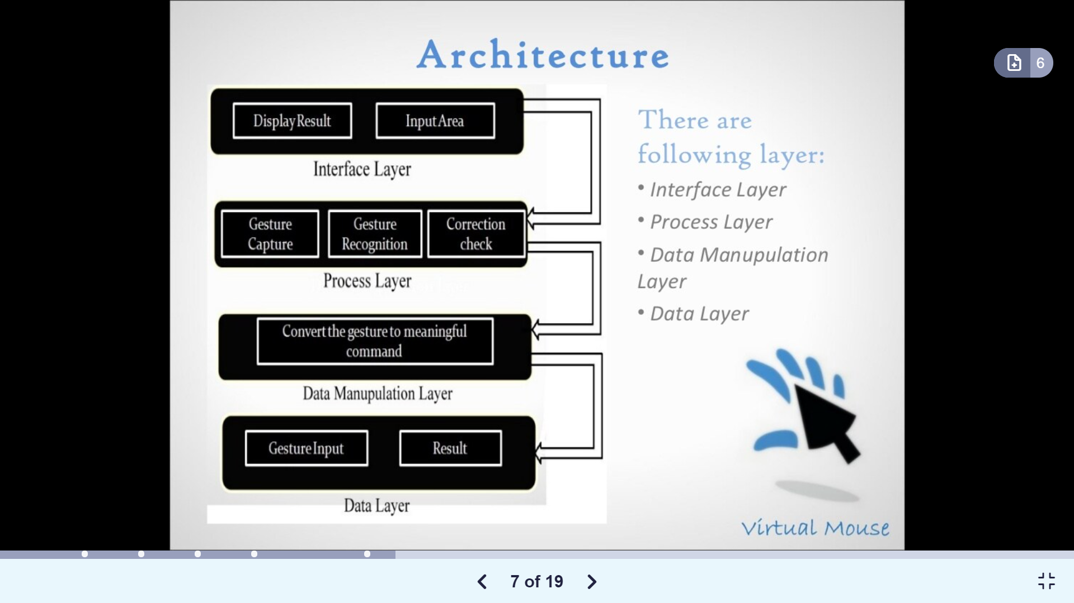
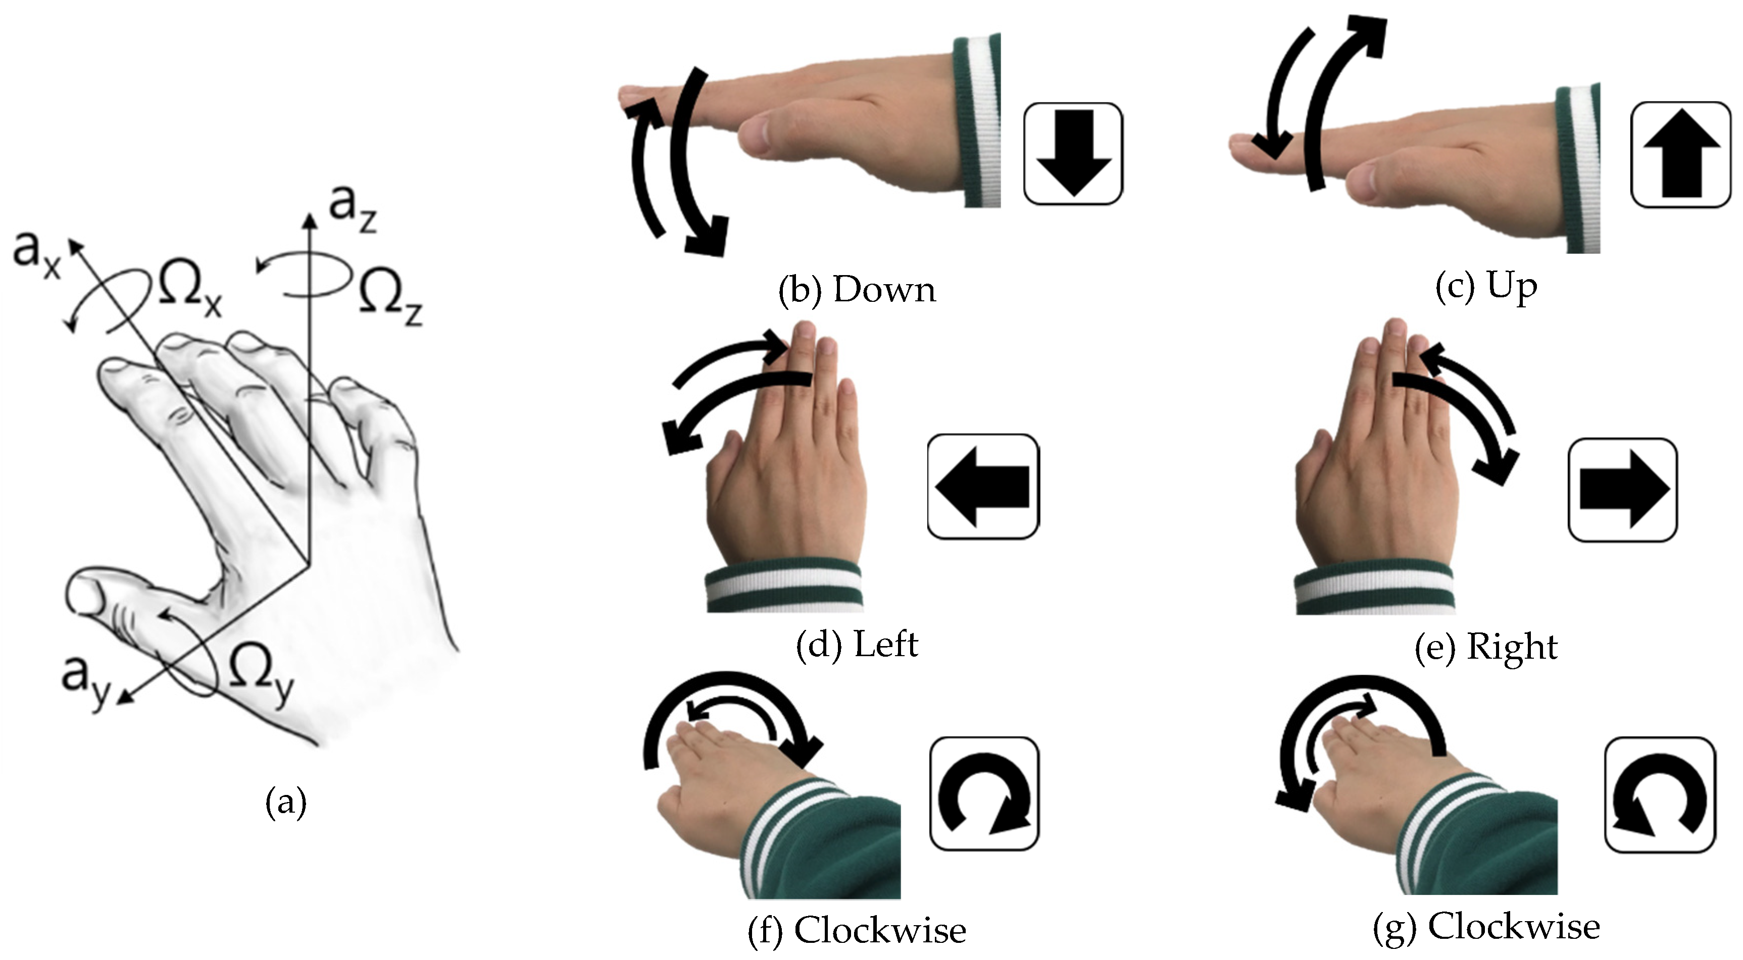
Architecture
Fig (a) : System Architecture
Fig (b) : Hand gestures

Slide 14

Step 1 : Initializing Holistic model and Drawing utils for detecting and drawing landmarks on the image.
Step 2 : Capture the frames continuously from the camera using OpenCV.
Step 3 : Convert the BGR image to an RGB image.
Step 4 : Check if any hand is detected or not.
Step 5 : If any hand was detected, we will then iterate through each detection.
Step 6 : Store the coordinate in a landmark list.
Step 7 : Image height (y) and image width(x) are multiplied with the result.
Step 8 : Draw the detected landmarks on the image.
Algorithm

Slide 15
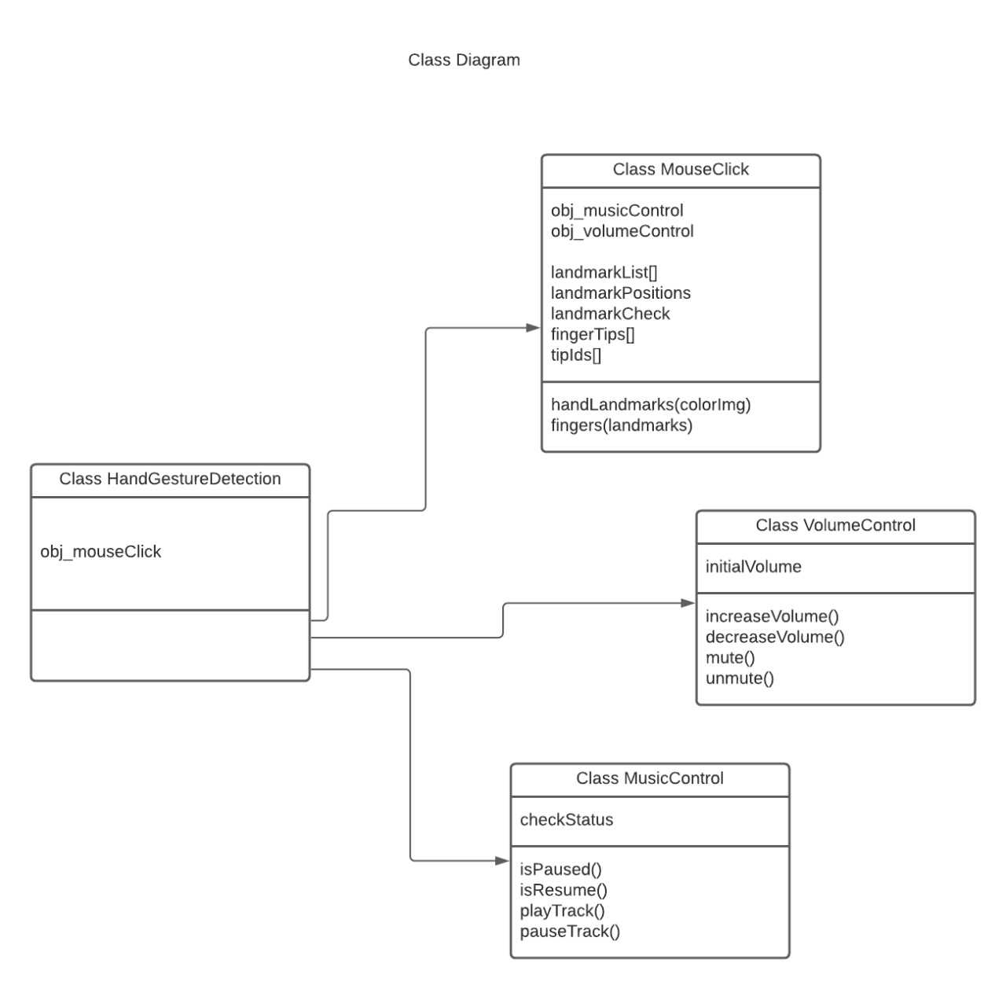
UML Diagrams
Class Diagram:

Slide 16
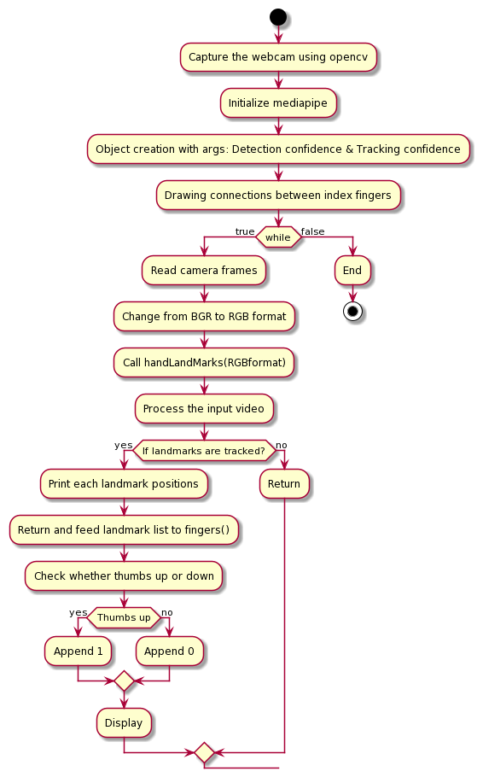
Activity Diagram:

Slide 17
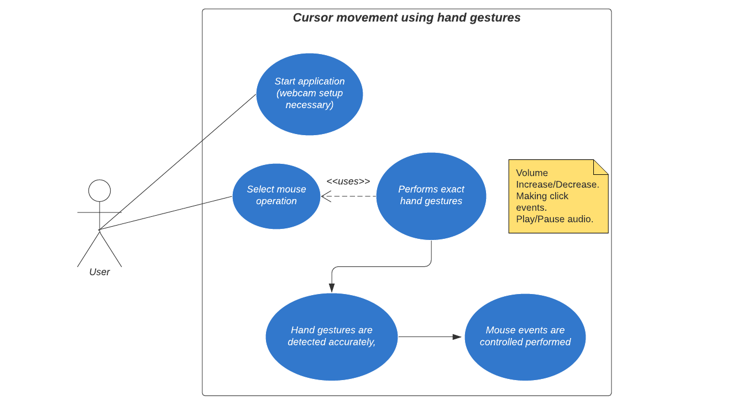
UseCase Diagram:

Slide 18
Conclusion & Future Scope
Gesture recognition gives the best interaction between human and machine.
Developed a virtual system where people can communicate with the computer without using any physical mouse.
The proposed system can be achieved by using a webcam or a built-in camera which detects the hand gestures and hand tip and processes these frames.
By detecting the hand gesture the system will perform some operation like cursor movement, left click, volume functions, etc.
We can add many features like dragging into this system using different gesture.
Furthermore, the proposed method can be developed to handle the keyboard functionalities along with the mouse functionalities virtually which is another future scope of Human-Computer Interaction (HCI)

Slide 19

Thankyou.
Made By:
Manasi Deshpande B1821101 Sakshi Kumari B1821102 Manasi Wader B1821103 Piyali Bedagkar B1821104

